Slide 1
Telecom Churn Exploratory Data Analysis and Prediction Model using logistic Regression
Presented By
Anish Nitin Somaiah

Slide 2
INDEX
PROBLEM STATEMENT
DATAFRAME ATTRIBUTES
OUTLIER ANALYSIS
EDA FOR CONTINUOS VARIABLES
EDA FOR CATEGORICAL VARIABLES
CORRELATION MATRICES
PREDICTION MODEL
THRESHOLD VALUE DETERMINATION
TUNED MODEL METRICS
PROCESS WORKFLOW
KEY FINDINGS SUMMARY

Slide 3
PROBLEM STATEMENT
THE BUSINESS CASE FOR OUR PROJECT IS TO DETERMINE THE PATTERN FOR CUSTOMER CHURN (CUSTOMER LEAVING A SERVICE) IN TELECOM COMPANIES USING EXPLORATORY DATA ANALYSIS OF CONTINUOUS AND CATEGORICAL DATA.
WE FURTHER BY USING LOGISTIC REGRESSION TO DETERMINE THE IMPORTANT PREDICTOR VARIABLES WHICH ARE FOCUS AREAS TO RETAIN CUSTOMERS AND SUSTAIN BUSINESS ACTIVITY.
FINAL STAGE IS TO ASSESS OUR PREDICTION MODEL USING METRICS SUCH AS SENSITIVITY, SPECIFICITY, ACCURACY AND AREA UNDER CURVE FOR MODEL IMPLEMENTATION.

Slide 4
DATA FRAME ATTRIBUTES
Categorical Dominant Dataset | Continual Dominant Dataset
customerID | state
gender | account length
SeniorCitizen | area code
Partner | phone number
Dependents | international plan
tenure | voice mail plan
PhoneService | number vmail messages
MultipleLines | total day minutes
InternetService | total day calls
OnlineSecurity | total day charge
OnlineBackup | total eve minutes
DeviceProtection | total eve calls
TechSupport | total eve charge
StreamingTV | total night minutes
StreamingMovies | total night calls
Contract | total night charge
PaperlessBilling | total intl minutes
PaymentMethod | total intl calls
MonthlyCharges | total intl charge
TotalCharges | customer service calls
Churn | churn

Slide 5
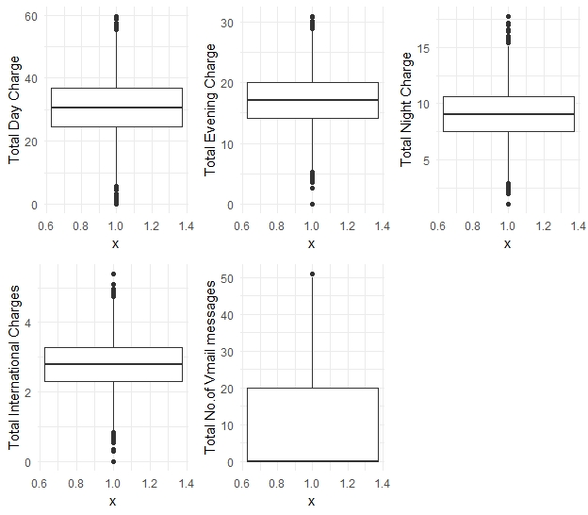
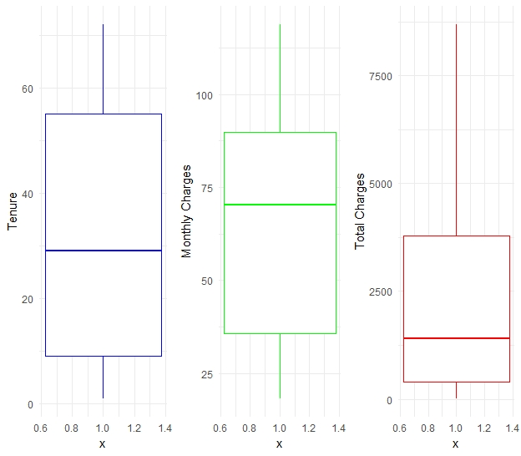
OUTLIER ANALYSIS
Categorical dataframe
Continual dataframe

Slide 6

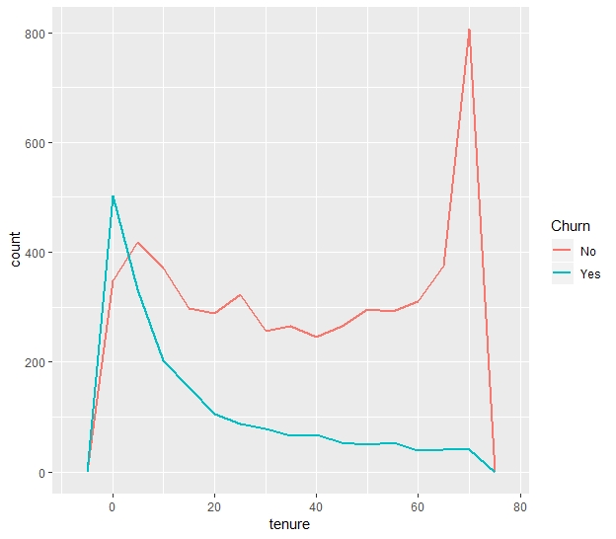
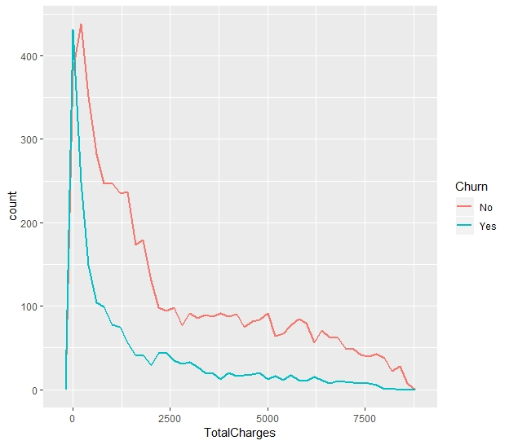
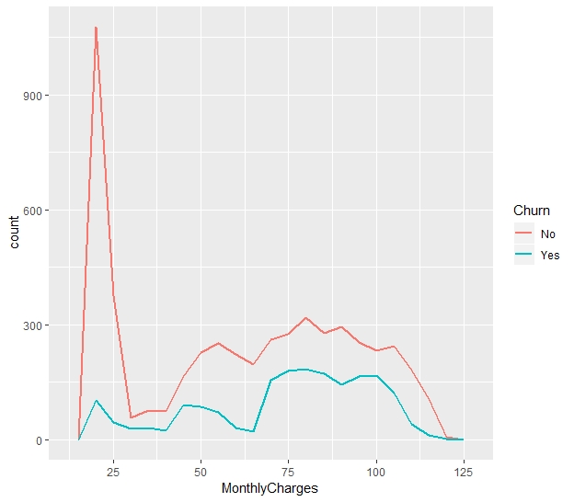
Continuous Variable Analysis Categorical Dataframe

Slide 7
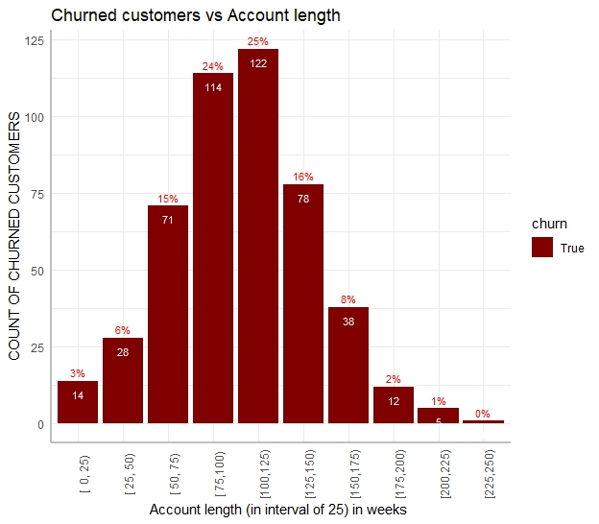
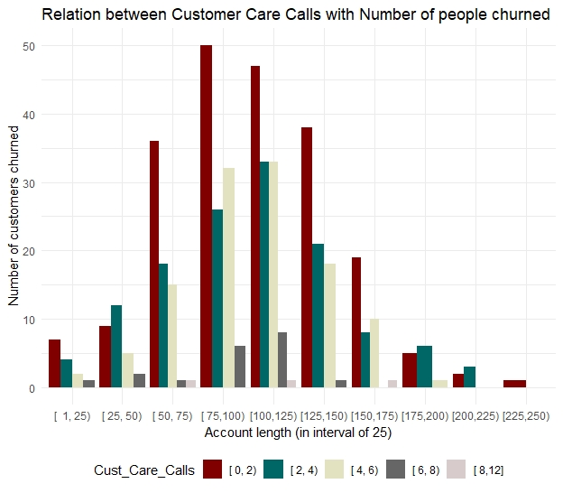
Continuous Variable Analysis Continual Dataframe

Slide 8
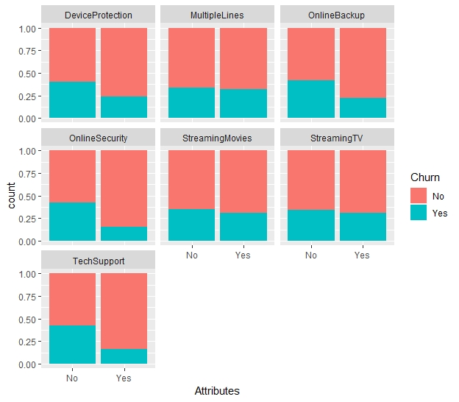
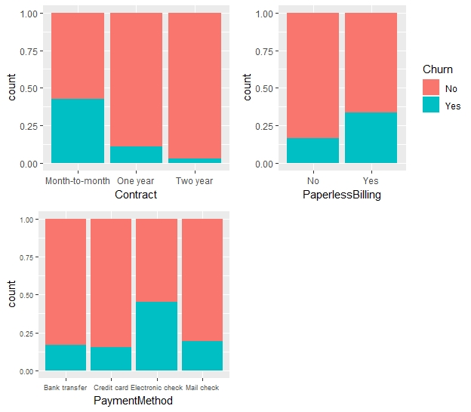
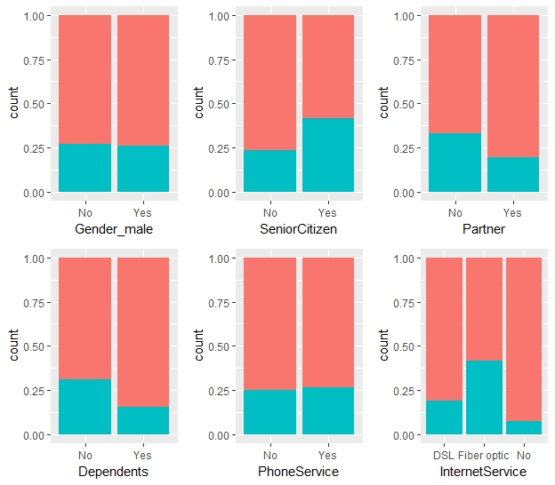
Categorical Variable Analysis Categorical Dataframe

Slide 9
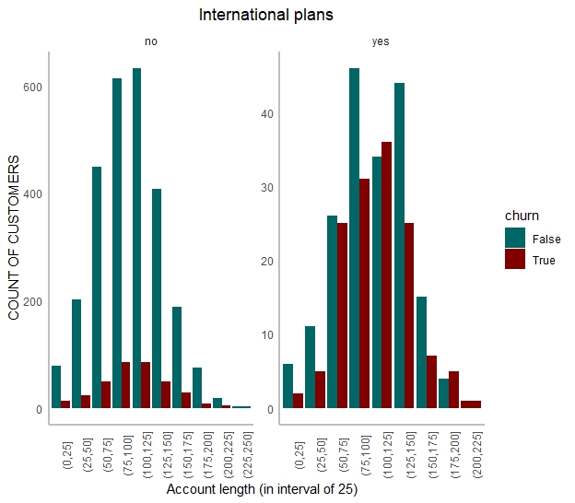
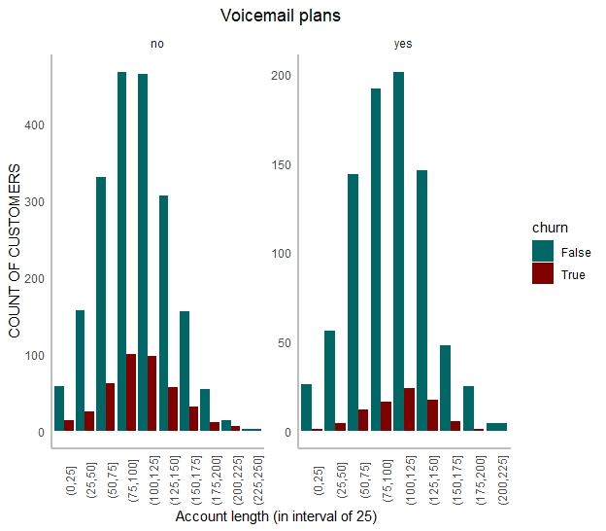
Categorical Variable Analysis Continual Dataframe

Slide 10
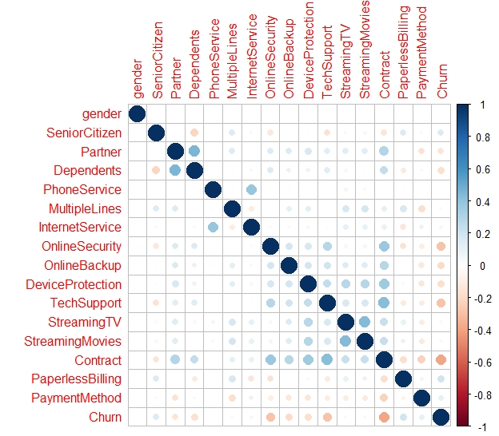
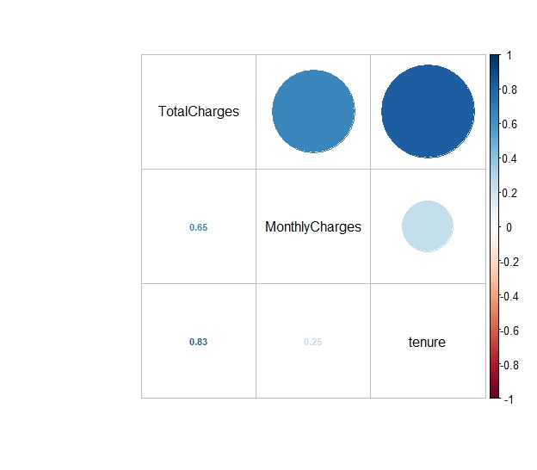
CORRELATION MATRICES Categorical

Slide 11
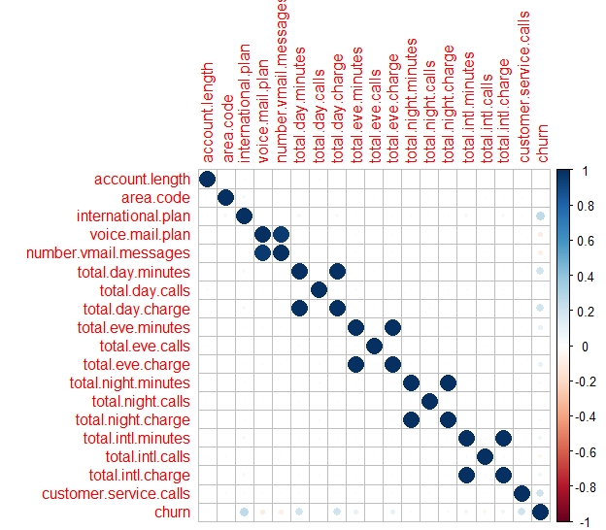
CORRELATION MATRIX Continual

Slide 12
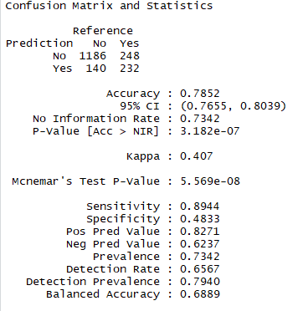
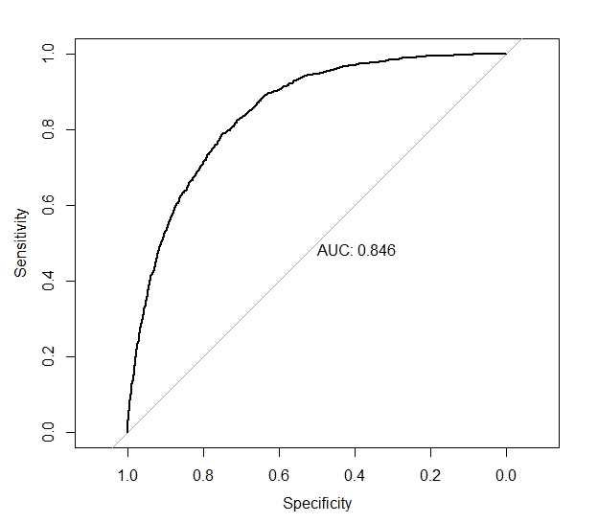
Initial Prediction model Metrics and ROC

Slide 13
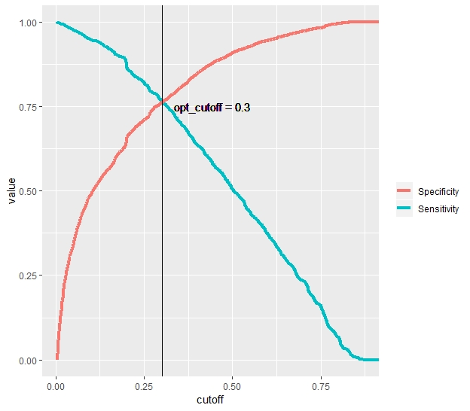
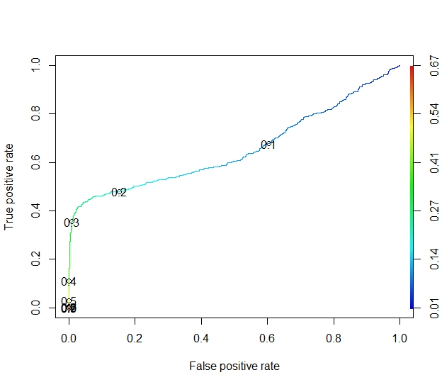
Finding Threshold cut-off values for prediction model
Categorical dataframe
Continual dataframe

Slide 14
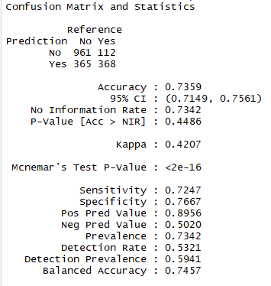
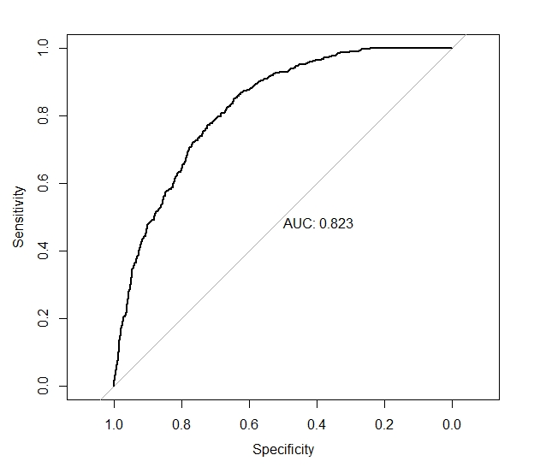
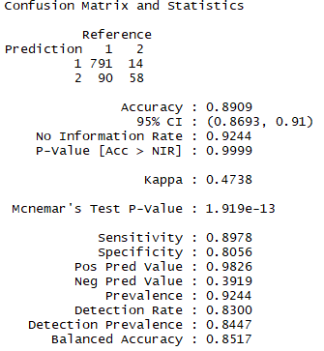
TUNED MODEL CONFUSION MATRICES
Categorical Tuned model
Confusion Matrix
Categorical Tuned model
ROC
Continual Tuned model
Confusion Matrix

Slide 15
Process workflow
Data Cleaning and Pre-Processing for Exploratory Data Analysis and Modelling to gain insights from the existing dataframe.
Outlier Analysis to be done for the continuous variables to ensure accuracy of the model.
Implement Logistic Regression on both models by obtaining main predictor variables using Correlation Matrix.
Finally predicting test data using the training model and calculating accuracy of test model using metrics such as Specificity, Sensitivity, Accuracy and AUC using Confusion Matrices and ROC curves.
Finetuning obtained model for better balanced accuracy using variance inflation factors and proper cutoff value estimation using graphs so that the Prediction Model that we propose to the organization facilitates the company to make necessary actions to retain customers, sustain business and compete against peer organizations in the market.
Comparison of Models and Data Visualizations are attached in the PPT.

Slide 16
KEY FINDINGS SUMMARIZED
The distributions for tenure are very different between customers who churned and who didn’t churn. For customers who churned, the distribution is positive skew, which means customers who churned are more likely to cancel the service in the first couple of months. For current customers who didn’t churn, there are two spikes. The second spike is much more drastic than the first one, which means a large group of current customers have been using the service more than 5 years.
The final Logistic Regression Model (with threshold = 0.3) has Accuracy of 0.74 and the AUC is 0.82. Based on the P values for variables, PhoneService, InternetServiceDSL, OnlineBackup, Contract, PaperleslsBilling, PaymentMethodElectronic.check, MonthlyCharges, tenure in 0-1 year and 1-2 years have more significant influence on predicting churn.
Among all the customers who churned ,Maximum percentage churn is observed in account length bracket of [100,125) weeks. Majority Proportion of customers who have churned received less customer service calls so we infer that one of the reasons of churn is the lack of attention of company towards customer
Churn percentage is more for people with international plans and less for voicemail plans. Hence International plans are to be improved but voicemail plans is not a significant predictor.
Positive correlation between all charges and churn indicate that churned customers have paid more charges and have been significant contributors for business.
Hence in continual model, pricing is a key factor for customer retention along with regular service check through customer care.

Slide 17
THANK YOU

